Slide 1
Companion PowerPoint slide set The Exposome: Investigating Vinyl Chloride and DNA Damage
This teacher slide set was created by Dana Haine, MS, of the UNC-Chapel Hill Superfund Research Program (SRP), which is funded by the National Institute of Environmental Health Sciences (P42ES005948).

Slide 2
The Exposome
This term refers to an individual’s lifetime exposure to chemicals from the environment coupled with exposure to chemicals formed inside of cells as a consequence of natural biological processes.
Exogenous Chemicals
Air
Food and drugs
Water
Consumer products
Endogenous Chemicals
Metabolism
Oxidative stress
Inflammation
Infection
Gut microbes

Slide 3
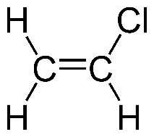
Vinyl Chloride
Vinyl chloride is a colorless gas with a mild, sweet odor.
It is a man-made chemical that does not occur naturally.
It can be formed when trichloroethane, trichloroethylene, and tetrachloroethylene are broken down.
Vinyl chloride is used in the production of polyvinyl chloride (PVC).
Vinyl chloride is a known human and animal carcinogen.
Carcinogenic (cancer-causing) response is associated with high exposure (>50 ppm).
Vinyl chloride is present in many Superfund sites and some public drinking water in ppb amounts.

Slide 4
Dr. Swenberg is a leading toxicologist investigating DNA damage caused by exposure to both endogenous and exogenous chemicals such as vinyl chloride.

Slide 5
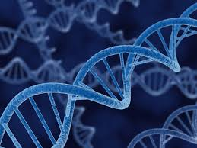
Vinyl Chloride & DNA Adducts
DNA adducts form when a chemical ( ) covalently binds to DNA.
Vinyl chloride produces four kinds of DNA adducts.
DNA adducts are a kind of DNA damage. This kind of damage can also be referred to as a DNA lesion.

Slide 6
Vinyl Chloride (VC) Exposure
Inside the body, vinyl chloride metabolism produces four kinds of DNA adducts. These four adducts can also occur inside cells under normal metabolic conditions in the absence of VC exposure!
.
Exogenous exposure
Air
Water
Endogenous Chemicals
Lipid Peroxidation

Slide 7
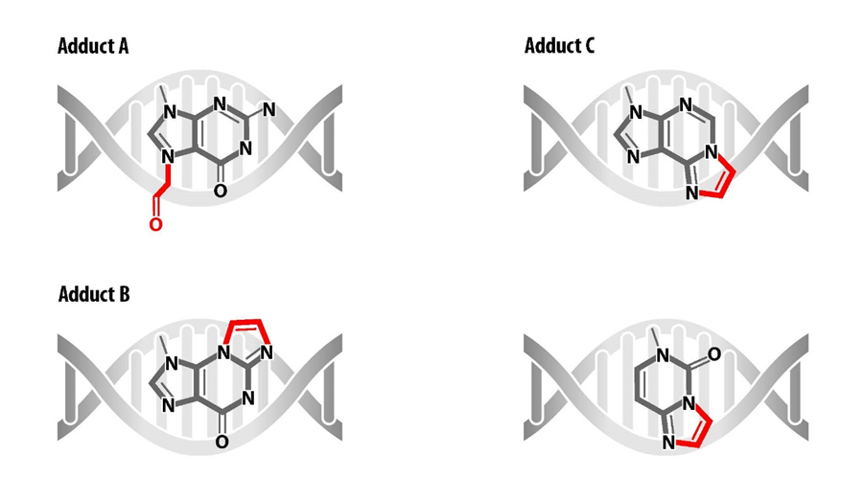
Exogenous exposure
Vinyl Chloride Exposure
Four types of adducts form; each is a modified nitrogenous base!
DNA Adduct Formation
In this activity we are going to study adducts labeled A-C.
Lipid peroxidation
Endogenous Chemicals

Slide 8
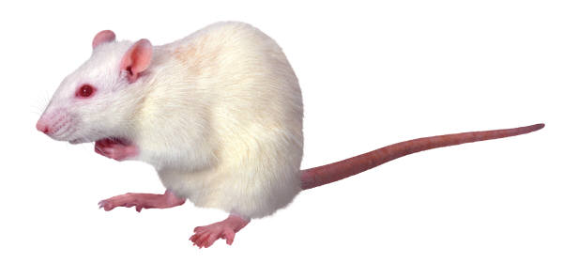
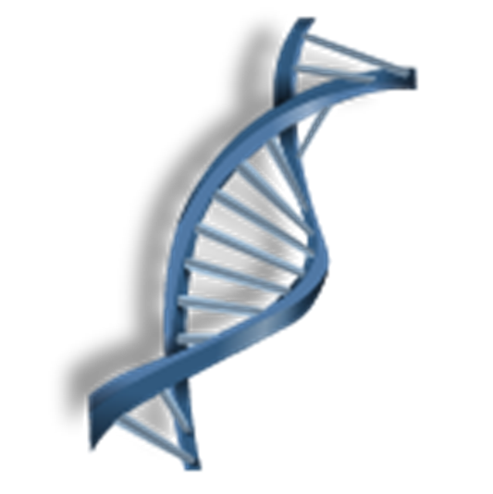
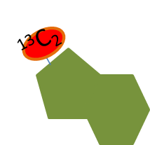
How to distinguish between exogenous and endogenous adducts?
¹³C₂
VC
¹³C₂
Stable-Isotope labeled
Vinyl Chloride (VC)
¹³C₂
Intermediate VC metabolite
(Chloroethylene oxide (CEO))
Stable-Isotope labeled
DNA Adduct
VC induced adducts will have stable-isotope labels; endogenous adducts will NOT.

Slide 9
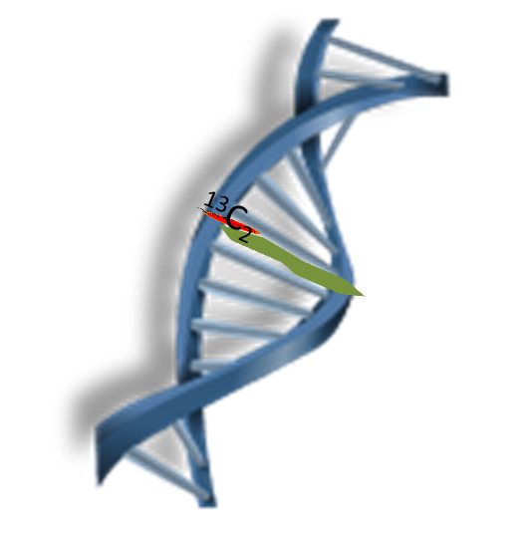
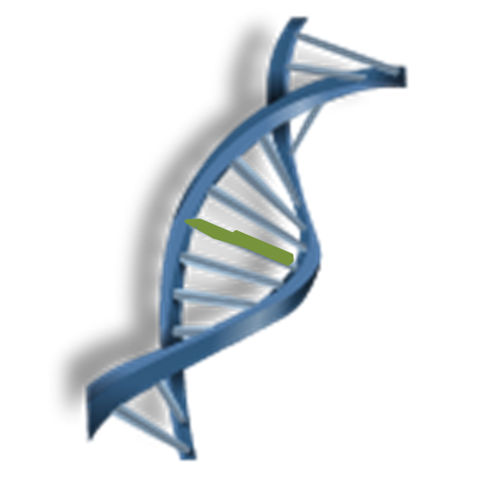
Measure the amount of labeled versus unlabeled adducts
Endogenous (unlabeled)
Exogenous (labeled)

Slide 10
Relative Amounts of Endogenous and Exogenous DNA Adducts in Liver DNA From Rats Exposed to [¹³C₂]-VC (1100 ppm, 6 hr/day, 5 days)
Unlabeled adducts
 | Adduct A |  | Adduct B |  | Adduct C
 | [¹²C₂]- 7OEG/ 10⁵ Gua | [¹³C₂]- 7OEG/ 10⁵ Gua | [¹²C₂]- N²,3-εG/ 10⁸ Gua | [¹³C₂]- N²,3-εG/ 10⁸ Gua | [¹²C₂]- 1N⁶- εdA/ 10⁸ dA | [¹³C₂]- 1N⁶- εdA/ 10⁸ dA
 | Endogenous | Exogenous | Endogenous | Exogenous | Endogenous | Exogenous
Two Hours Post Exposure | 0.2 ± 0.1 | 10.4 ± 2.3 | 4.1 ± 2.8 | 18.9 ± 4.9 | 4.9 ± 0.6 | 5.1 ± 0.6
2 Weeks Post Exposure | 0.1 ± 0.03 | 0.4 ± 0.3 | 3.7 ± 3.1 | 14.2 ± 4.2 | 8.6 ± 0.9 | Not detected
4 Weeks Post Exposure | 0.2 ± 0.04 | 0.1± 0.06 | 3.1 ± 1.0 | 16.9 ± 1.6 | 6.2 ± 1.3 | Not detected
8 Weeks Post Exposure | 0.2 ± 0.07 | Not detected | 3.7 ± 1.5 | 13.2 ± 2.5 | 4.1 ± 0.5 | Not detected
Labeled adducts
Notes:
J. Nakamura, Esra Mutlu, Vyom Sharma, Leonard Collins, Wanda Bodnar, Rui Yu, Yongquan Lai,
Benjamin Moeller, Kun Lu, James Swenberg. The endogenous exposome. DNA Repair 19 (2014) 3–13.
http://www.sciencedirect.com/science/article/pii/S1568786414001025

Slide 11
Relative Amounts of Endogenous and Exogenous DNA Adducts in Liver DNA From Rats Exposed to [¹³C₂]-VC (1100 ppm, 6 hr/day, 5 days)
 | Adduct A |  | Adduct B |  | Adduct C
 | [¹²C₂]- 7OEG/ 10⁵ Gua | [¹³C₂]- 7OEG/ 10⁵ Gua | [¹²C₂]- N²,3-εG/ 10⁸ Gua | [¹³C₂]- N²,3-εG/ 10⁸ Gua | [¹²C₂]- 1N⁶- εdA/ 10⁸ dA | [¹³C₂]- 1N⁶- εdA/ 10⁸ dA
 | Endogenous | Exogenous | Endogenous | Exogenous | Endogenous | Exogenous
Two Hours Post Exposure | 0.2 ± 0.1 | 10.4 ± 2.3 | 4.1 ± 2.8 | 18.9 ± 4.9 | 4.9 ± 0.6 | 5.1 ± 0.6
2 Weeks Post Exposure | 0.1 ± 0.03 | 0.4 ± 0.3 | 3.7 ± 3.1 | 14.2 ± 4.2 | 8.6 ± 0.9 | Not detected
4 Weeks Post Exposure | 0.2 ± 0.04 | 0.1± 0.06 | 3.1 ± 1.0 | 16.9 ± 1.6 | 6.2 ± 1.3 | Not detected
8 Weeks Post Exposure | 0.2 ± 0.07 | Not detected | 3.7 ± 1.5 | 13.2 ± 2.5 | 4.1 ± 0.5 | Not detected
Notes:
J. Nakamura, Esra Mutlu, Vyom Sharma, Leonard Collins, Wanda Bodnar, Rui Yu, Yongquan Lai,
Benjamin Moeller, Kun Lu, James Swenberg. The endogenous exposome. DNA Repair 19 (2014) 3–13.
http://www.sciencedirect.com/science/article/pii/S1568786414001025

Slide 12
Analyzing and interpreting data Student Worksheet

Slide 13
Answer Key
Short half-life
Unstable adduct
Long half-life
Not repaired
Short half-life
Quick repair

Slide 14
Half-life for VC-Induced DNA Adducts
Adduct | Half-life
Adduct A | 4 Days
Adduct B | 150 Days
Adduct C | ~1 Day

Slide 15
Miscoding Properties of Vinyl Chloride DNA Adducts
Adduct A | None
Adduct B | G → A
Adduct C | A → T A → C A → G

Slide 16
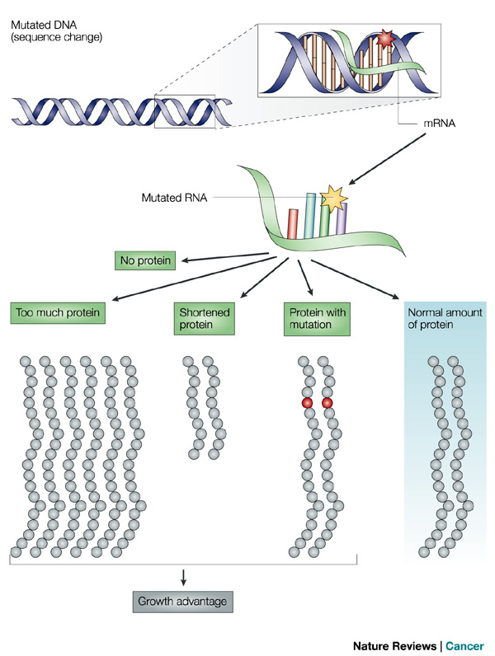
DNA adduct
What happens if a DNA adduct does not get repaired?
Reprinted by permission from Macmillan Publishers Ltd: Nature Reviews Cancer 4, 630-637 (August 2004).
Notes:
http://www.nature.com/nrc/journal/v4/n8/fig_tab/nrc1410_F2.html

