Slide 1
Companion PowerPoint slide set DNA wrap: Packaging matters
This teacher slide set was created by Dana Haine, MS, of the UNC Superfund Research Program, which is funded by the National Institute of Environmental Health Sciences (P42ES005948).

Slide 2
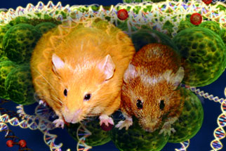
Same genes, different phenotypes
NOVA’s
A Tale of Two Mice: Chapter 1

Slide 3
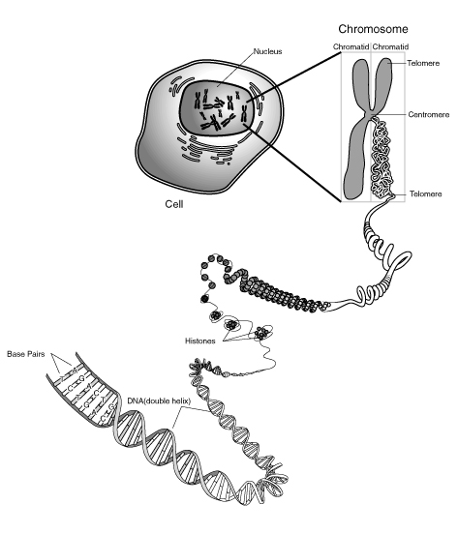
Condensed
Chromatin
Hydrogen Bonds
(between bases)
Decondensed
Chromatin
Nucleotide
(consists of a base,
a 5-carbon sugar,
and a phosphate group)
Phosphodiester Bond
(between adjacent nucleotides)
http://commons.wikimedia.org/wiki/File:Chromosome.gif

Slide 4
What is Epigenetics?
Refers to changes in gene expression caused by mechanisms other than changes in the underlying DNA sequence.
Enables a cell/organism to respond to its dynamic external environment during development and throughout life!
Epigenetic changes to the genome can be inherited if these changes occur in cells giving rise to gametes

Slide 5
Two Epigenetic Mechanisms
DNA Methylation
Histone Modifications

Slide 6
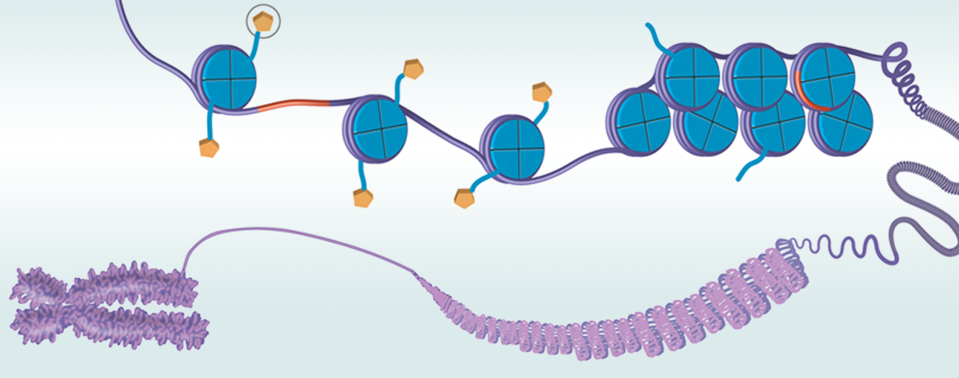
1. Histone modification
If the way that DNA is wrapped around the histones changes, gene expression can change as well.
Histone
Modification
http://ehp.niehs.nih.gov/wp-content/uploads/2012/09/WP_Focus_2_Title_web.png

Slide 7
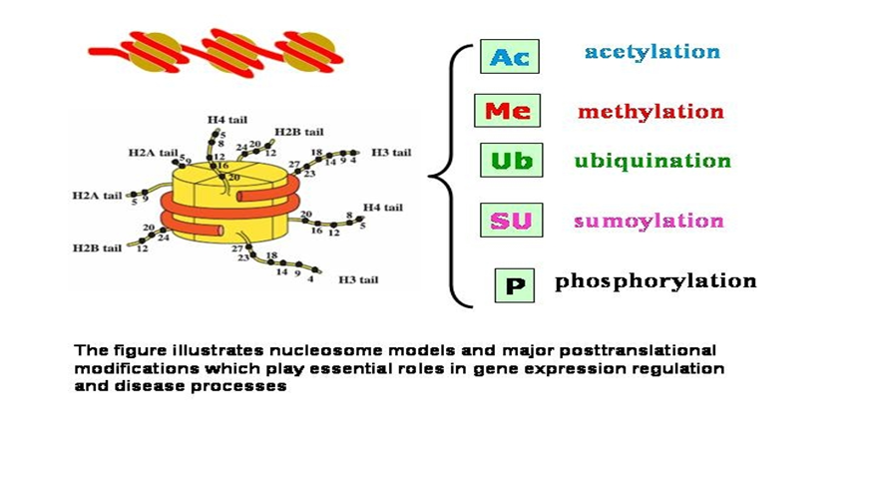
Post-translational histone modifications
Notes:
Although histone modifications occur throughout the entire sequence, the unstructured N-termini of histones (called histone tails) are particularly highly modified.

Slide 8
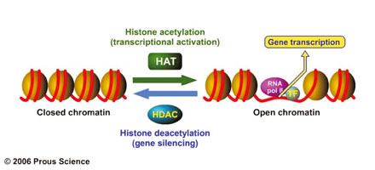
Acetylation is the most highly studied

Slide 9
2. DNA methylation
The addition of methyl groups to DNA, mostly at CpG sites, to convert cytosine to 5-methylcytosine.
5’
3’
SAM
C G T A C A C G A C A C G A T
G C A T G T G C T G T G C T A
3’
5’
Notes:
represent potentially heritable changes to the genome

Slide 10
DNA Methylation leads to gene silencing
Target gene expressed in normal cell
Normal State
RNA pol
TF
Target gene
expressed
Promoter
Target gene inactivated by DNA methylation
Epigenetic Modification
TF
X
Target gene
not expressed
Promoter
Notes:
DNA methylation at promoter regions can impede target gene expression
CpG sites are regions of DNA where a cytosine nucleotide occurs next to a guanine nucleotide in the linear sequence of bases along its length.
*"CpG" stands for cytosine and guanine separated by a phosphate (—C—phosphate—G—), which links the two nucleosides together in DNA.

Slide 11
1) Changes to DNA Methylation leads to gene silencing
Target gene expressed in normal cell
e.g., tumor suppressor gene
Normal State
RNA pol
TF
Target gene
expressed
Promoter
Target gene inactivated by hypermethylation
Disease State arising from Epigenetic Modification
TF
X
Target gene
not expressed
Promoter
Notes:
DNA methylation at promoter regions can impede target gene expression
CpG sites are regions of DNA where a cytosine nucleotide occurs next to a guanine nucleotide in the linear sequence of bases along its length.
*"CpG" stands for cytosine and guanine separated by a phosphate (—C—phosphate—G—), which links the two nucleosides together in DNA.

Slide 12
2) Changes to DNA Methylation leads to gene activation
Target gene silenced by methylation
e.g., oncogene
Normal State
TF
X
Target gene
not expressed
Promoter
Target gene activated by hypomethylation
or demethylation
Disease State arising from Epigenetic Modification
RNA pol
TF
Target gene
expressed
Promoter
Notes:
DNA methylation at promoter regions can impede target gene expression
CpG sites are regions of DNA where a cytosine nucleotide occurs next to a guanine nucleotide in the linear sequence of bases along its length.
*"CpG" stands for cytosine and guanine separated by a phosphate (—C—phosphate—G—), which links the two nucleosides together in DNA.

Slide 13
How did these mice become different?
NOVA’s
A Tale of Two Mice
Chapters 2 &3

Slide 14
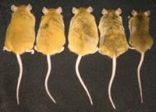
Experiment: Does maternal diet influence expression of the Agouti gene?
Female mice were fed genistein, the major phytoestrogen in soy, before and during pregnancy. Genetically identical offspring exhibited varying coat colors.

Slide 15
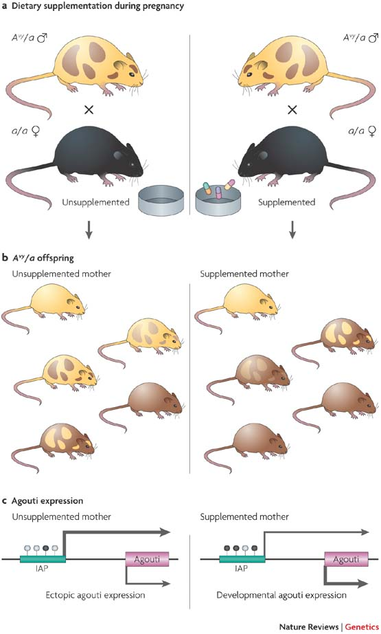
Environmental epigenomics and disease susceptibility
Randy L. Jirtle and Michael K. Skinner
Nature Reviews Genetics 8, 253-262 (April 2007)
http://www.nature.com/nrg/journal/v8/n4/fig_tab/nrg2045_F2.html
Notes:
From the following article:
Environmental epigenomics and disease susceptibility
Randy L. Jirtle and Michael K. Skinner
Nature Reviews Genetics 8, 253-262 (April 2007)

Slide 16
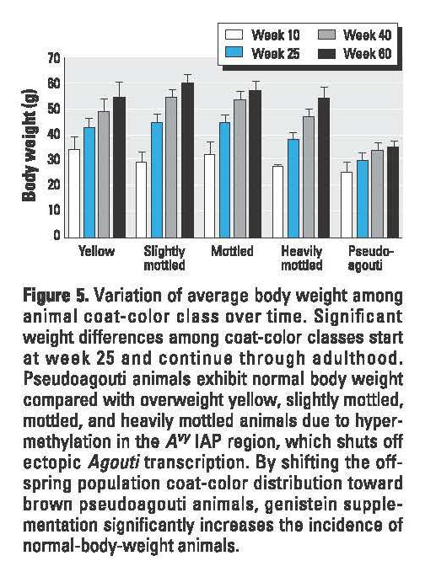
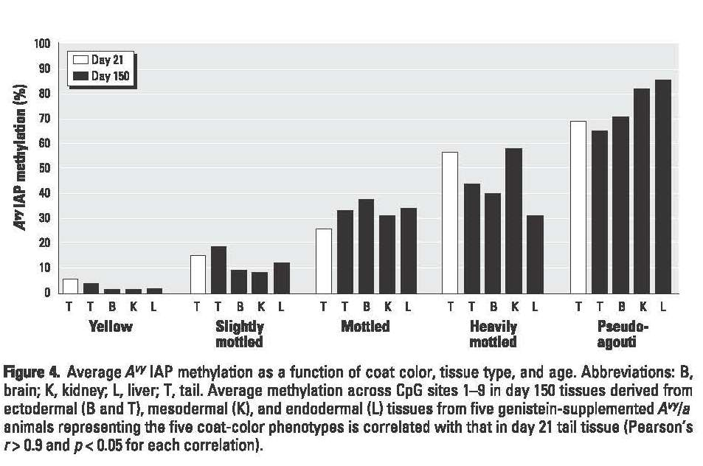
Experimental results

Slide 17
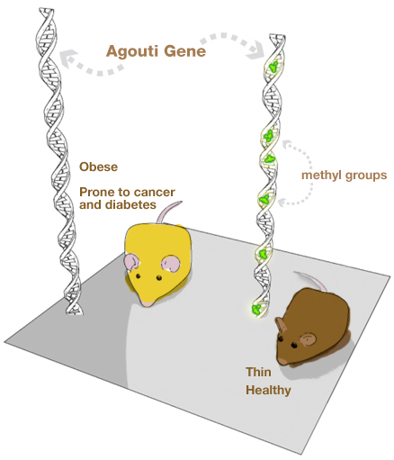
Conclusions
Read the authors’ conclusions and with a partner discuss how these conclusions could be relevant for humans.
Genetic Science Learning Center, University of Utah

Slide 18
Conclusions
Diet, especially during pregnancy, can influence our epigenome and ultimately determine our susceptibility to cancer and disease.
Genetic Science Learning Center, University of Utah

