Slide 1

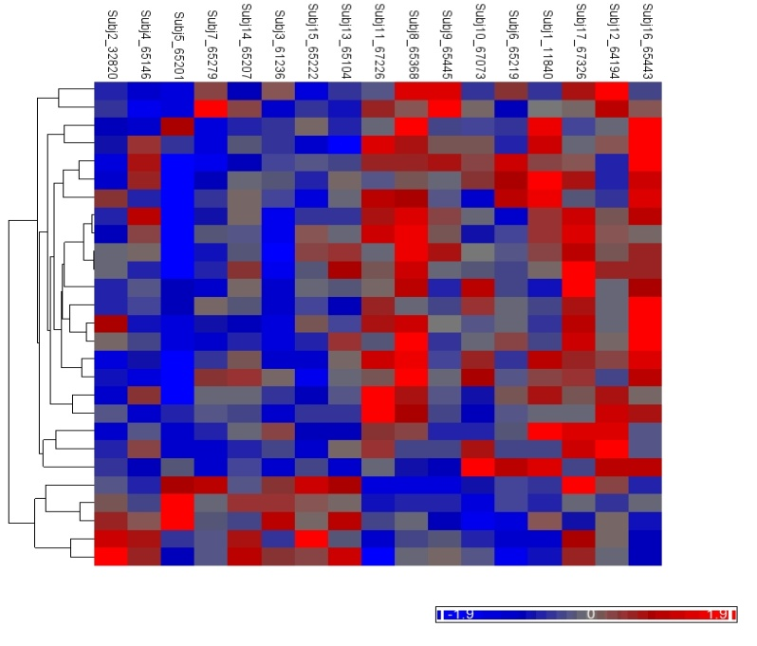

Companion PowerPoint slide set
DNA Methylation & Cadmium Exposure in utero
An Epigenetic Analysis Activity for Students
This teacher slide set was created by Dana Haine, MS, of the UNC-Chapel Hill Superfund Research Program, which is funded by the National Institute of Environmental Health Sciences (P42ES005948).

Slide 2
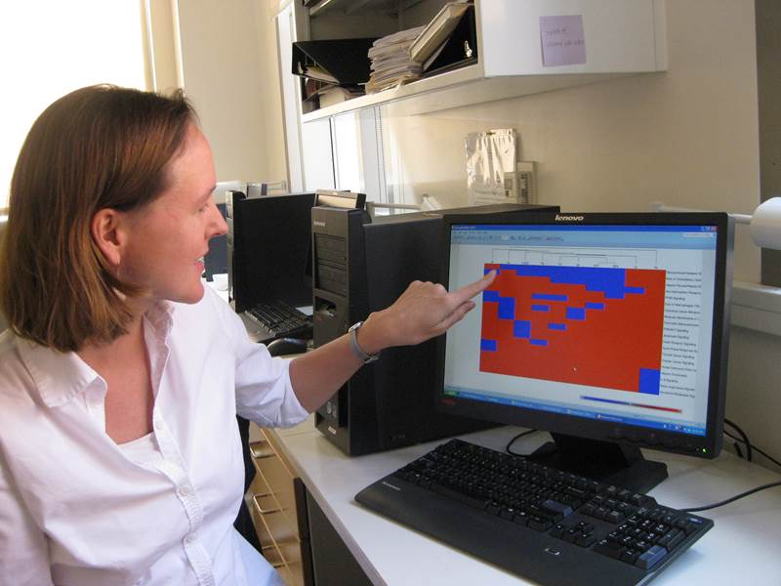
Rebecca Fry, Ph.D.
Scientist studying the link between prenatal exposure to arsenic and cadmium and newborn health.
Link to video describing her research.
Notes:
Uses systems toxicology to understand the molecular mechanisms by which early-life exposures to metals such as cadmium and arsenic are associated with long-term health effects in humans.

Slide 3
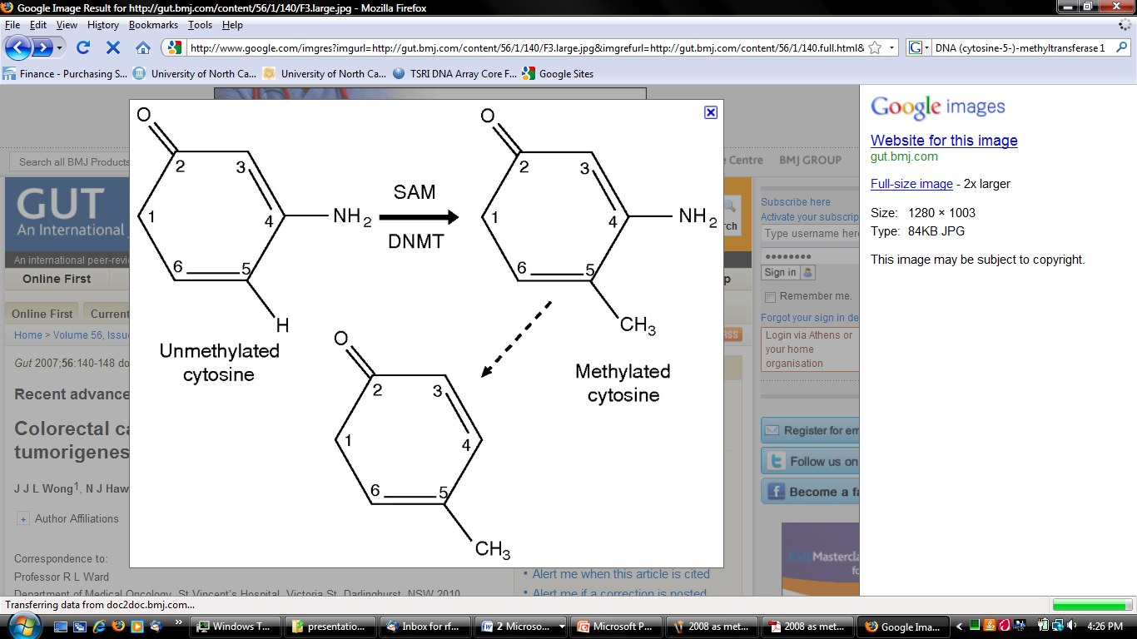

DNA methylation
The addition of methyl groups to DNA, mostly at CpG sites, to convert cytosine to 5-methylcytosine.
CpG site
5’
3’
SAM
C G T A C A C G A C A C G A T
G C A T G T G C T G T G C T A
3’
5’
Notes:
represent potentially heritable changes to the genome

Slide 4
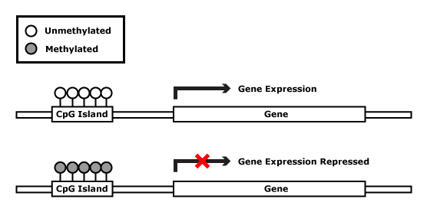
DNA methylation & gene expression
A simplified model
Image Credit: Rebecca Fry

Slide 5
Changes to DNA methylation can lead to gene silencing
Target gene expressed in normal cell
e.g., tumor suppressor gene
Normal State
RNA pol
TF
Promoter
Target gene
expressed
Target gene inactivated by hypermethylation
Disease State arising from Epigenetic Modification
TF
X
Promoter
Target gene
not expressed
Image Credit: Rebecca Fry
Notes:
DNA methylation at promoter regions can impede target gene expression
CpG sites are regions of DNA where a cytosine nucleotide occurs next to a guanine nucleotide in the linear sequence of bases along its length.
*"CpG" stands for cytosine and guanine separated by a phosphate (—C—phosphate—G—), which links the two nucleosides together in DNA.

Slide 6
Changes to DNA methylation can lead to gene activation
Target gene silenced by methylation
e.g., oncogene
Normal State
TF
X
Promoter
Target gene
not expressed
Target gene activated by hypomethylation
or demethylation
Disease State arising from Epigenetic Modification
RNA pol
TF
Promoter
Target gene
expressed
Image Credit: Rebecca Fry
Notes:
DNA methylation at promoter regions can impede target gene expression
CpG sites are regions of DNA where a cytosine nucleotide occurs next to a guanine nucleotide in the linear sequence of bases along its length.
*"CpG" stands for cytosine and guanine separated by a phosphate (—C—phosphate—G—), which links the two nucleosides together in DNA.

Slide 7
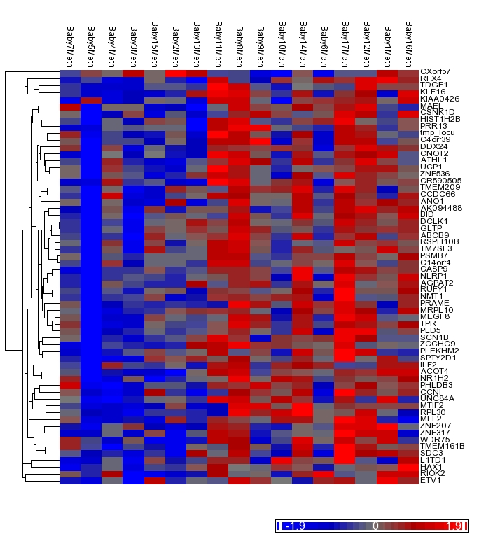
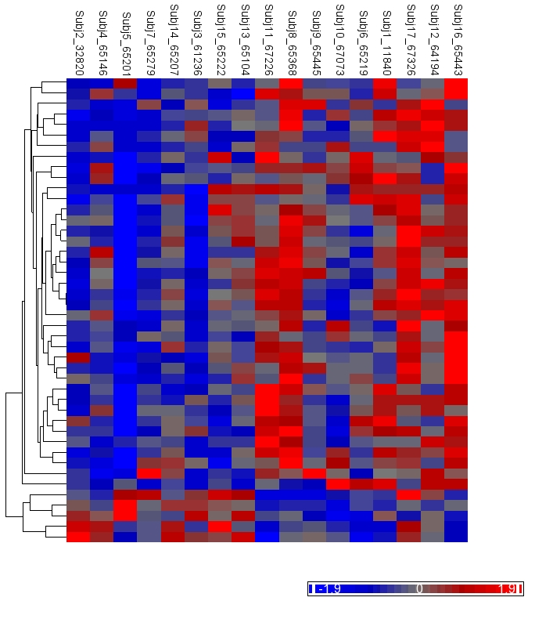
Heat Map Analysis
Level of Cadmium Exposure
Hypermethylation
Average
Hypomethylation
Lower Cadmium
Higher Cadmium
Sanders et al., 2014. Cadmium exposure and the epigenome.
Notes:
This heat map shows 61 differentially methylated genes (y axis) in 17 individuals (x axis).

Slide 8
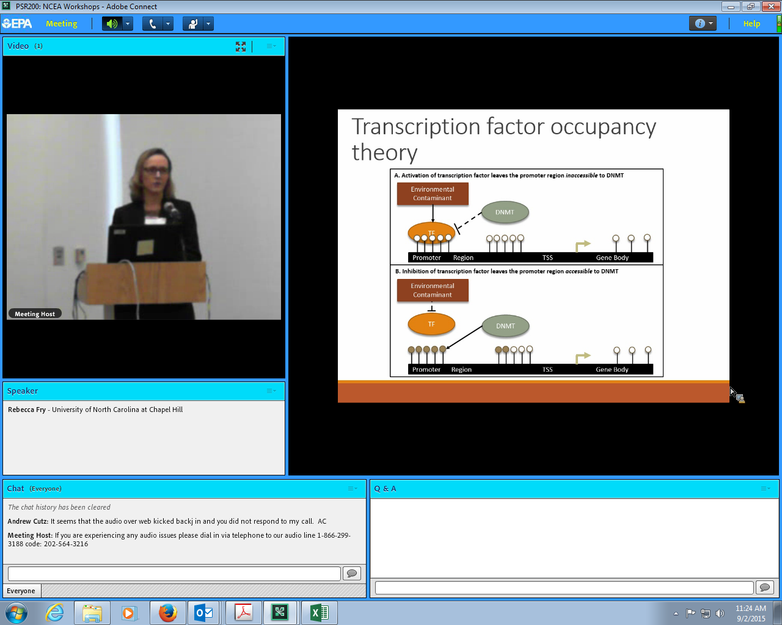

Transcription Factor Occupancy Theory
HYPOmethylation
Unmethylated DNA
Methylated DNA
HYPERmethylation
Martin et al., 2016. A cross-study analysis of prenatal exposures to environmental contaminants and the epigenome: support for stress-responsive transcription factor occupancy as a mediator of gene-specific CpG methylation patterning.

